Slide 1
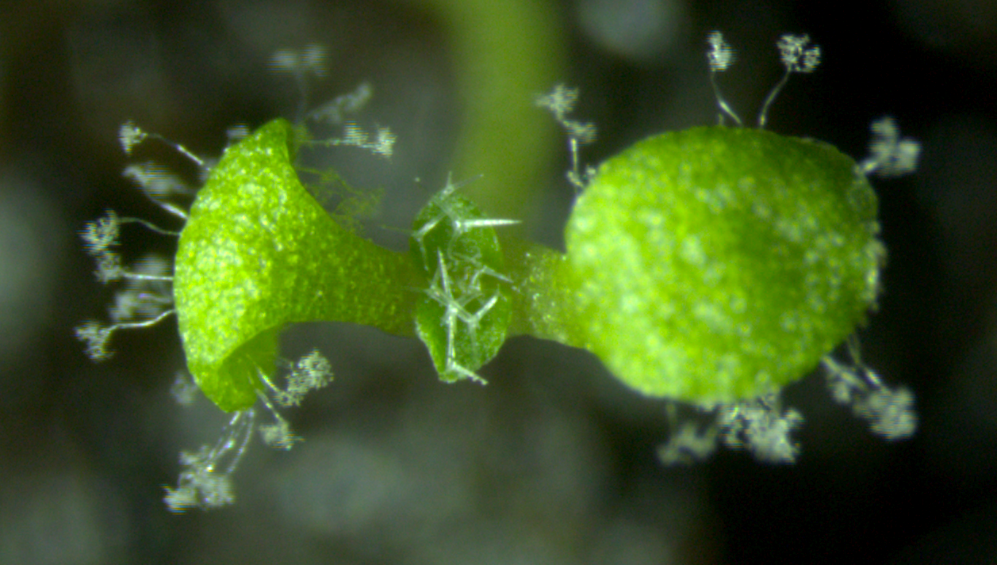

Hyaloperonospora arabidopsidis (Hpa)
Dae Sung Kim
Jonathan Jones group
The Sainsbury Laboratory
Norwich, UK

Slide 2
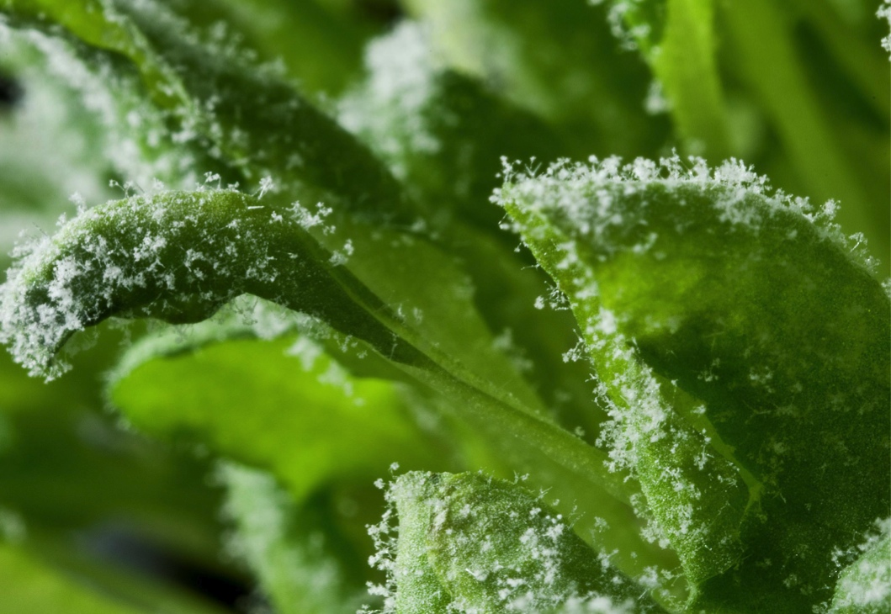
Hpa – a taxonomical odyssey…
Peronospora parasitica
Hyaloperonospora parasitica
Hyaloperonospora arabidopsidis

Slide 3
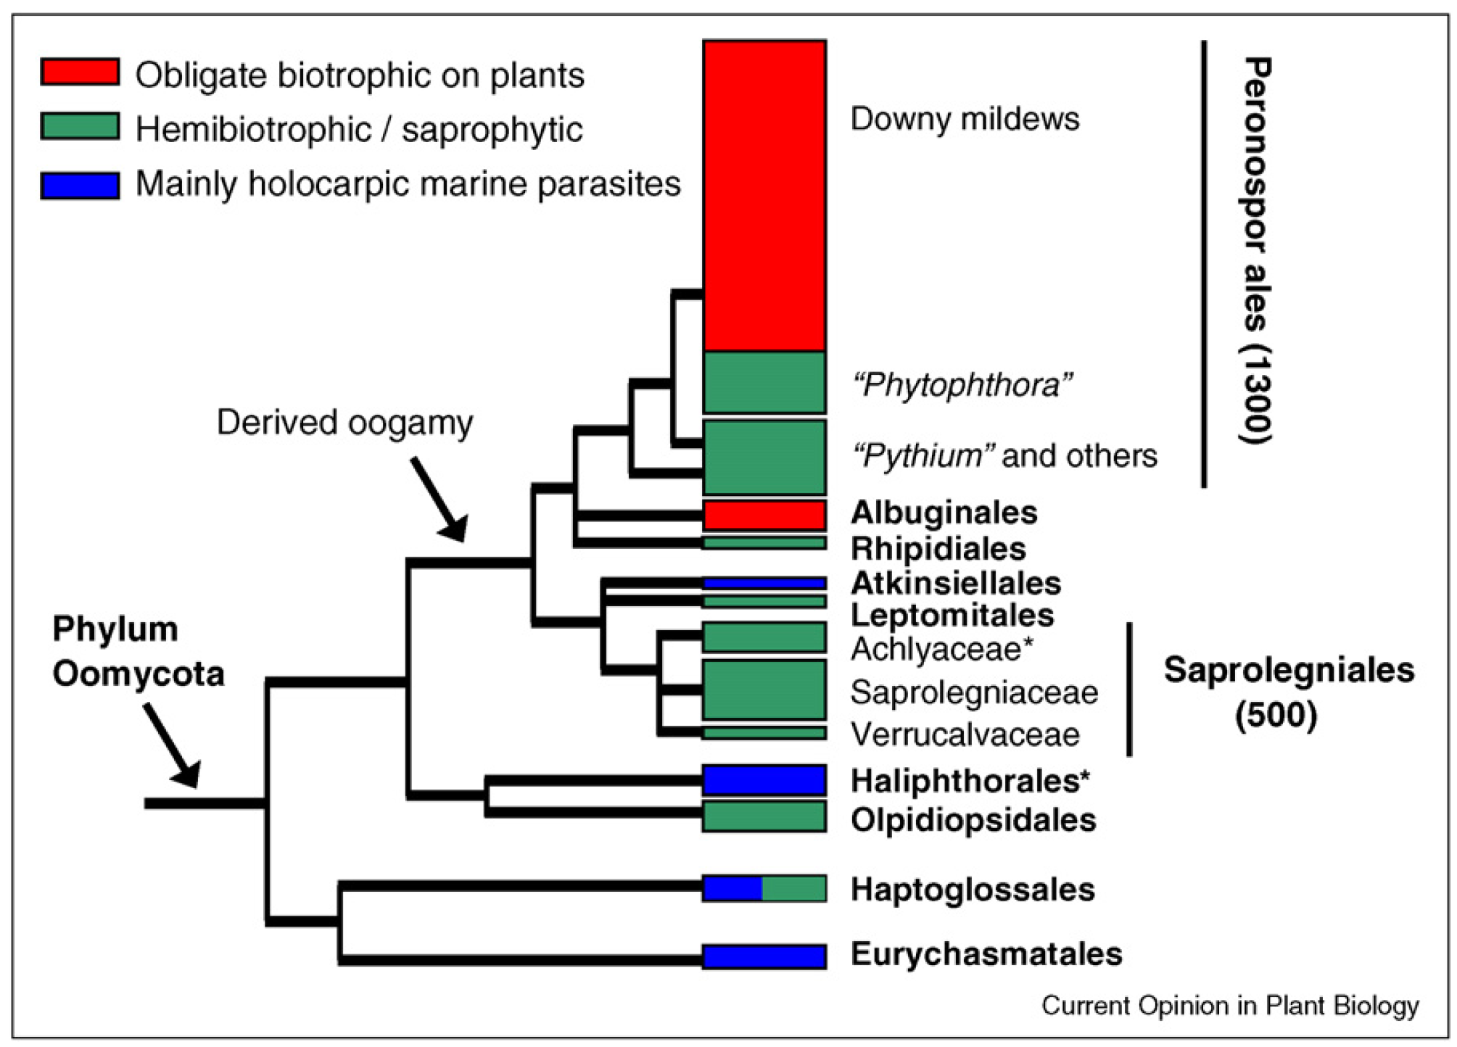
Hpa is in the Peronosporales
Thines and Kamoun, 2010.

Slide 4
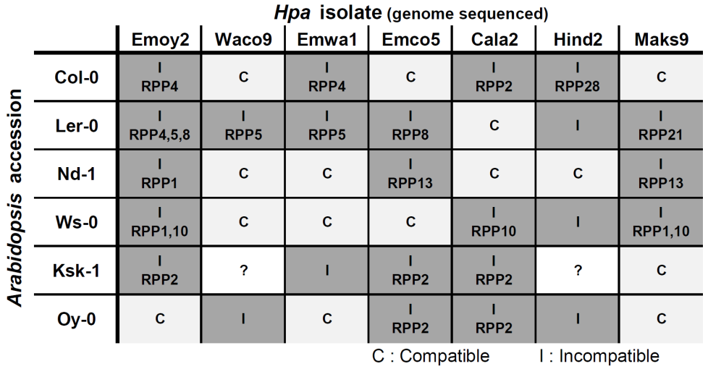
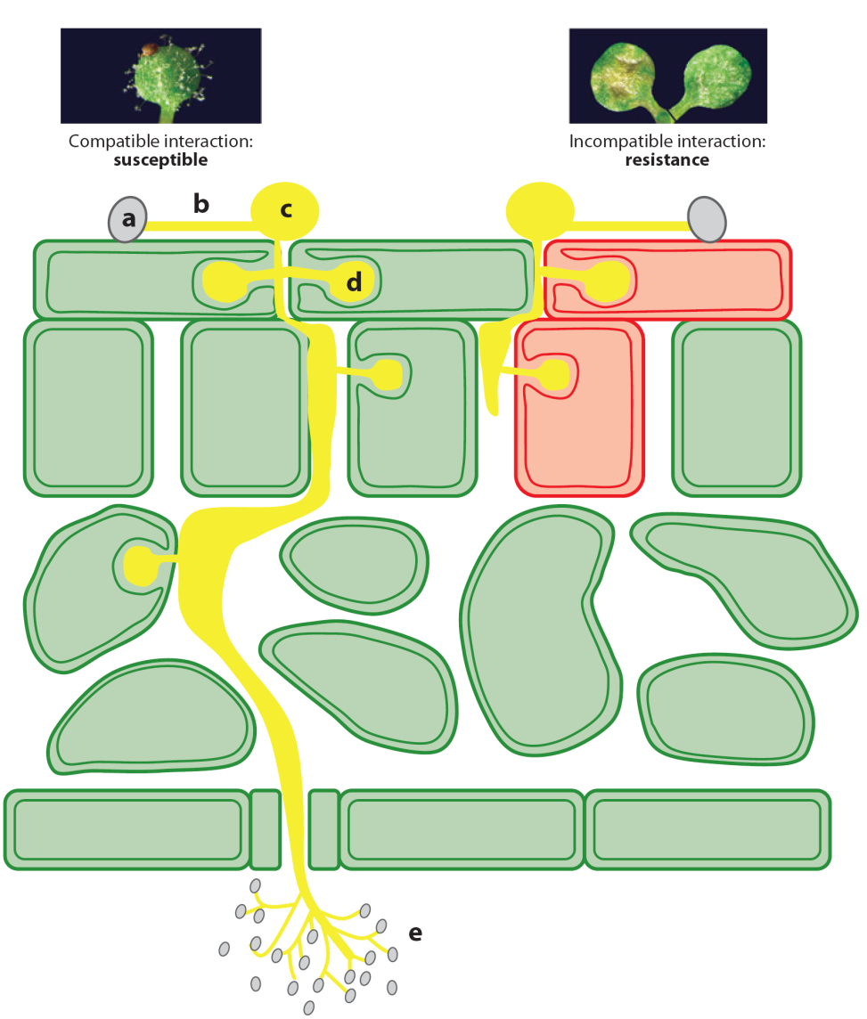
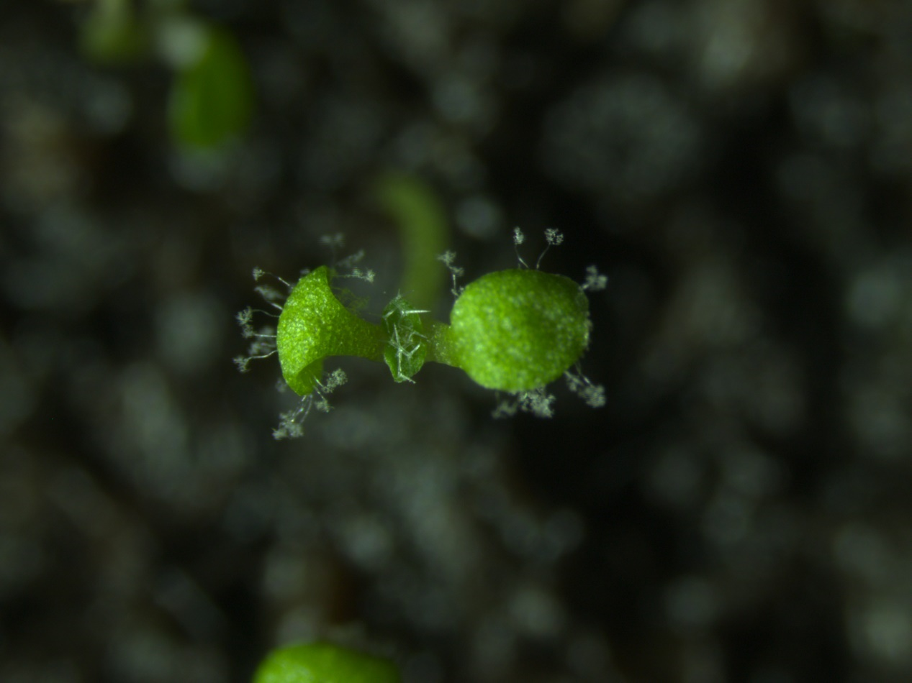
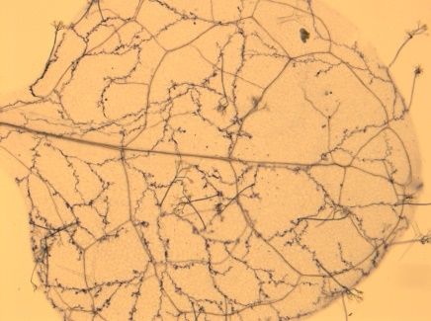
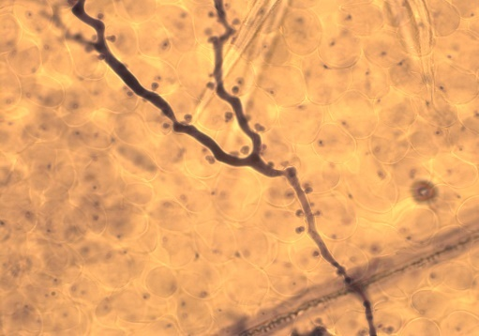
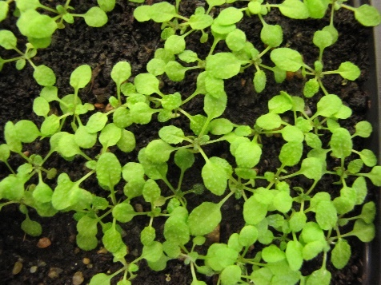
Compatible and incompatible interaction between plant-­Hpa
C
C
C
I
Coates and Beynon, 2010.
Notes:
Asexual spore land on the surface of the leaf, germinated to form a germ tube and formed an appresorium. then, penetration hypha formed and grows down. Haustoria penetrate the epidermal cells. through stomata, asexual spores are produced which are carried on conidiophores. ATR protein is recognized by its corresponding R protein, HR response resulting in cell death of the infected cells is occurred and successfully halting the infection.

Slide 5
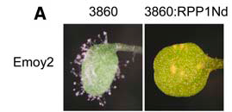
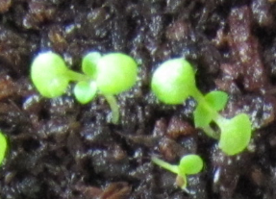
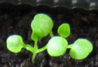
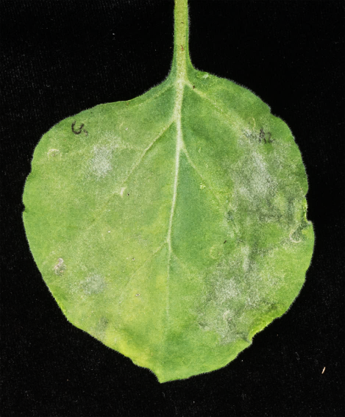
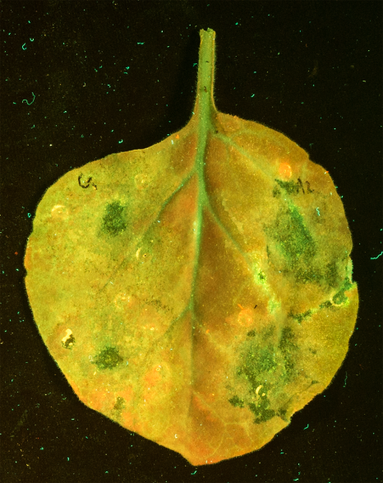
Effectors can be recognized by R genes
CW84
CW84:RPP2
Cala2
ATR2^{Cala2} allele
ATR1^{Emoy2} allele
Kim et al., Unpublished.
Rehmany et al., 2005.
Effectors promote virulence if there is no R gene
Visible
UV
GFP:00
A2C3:YFP
GFP:00
A2C3:YFP
GFP:00
A2C3:YFP
GFP:00
A2C3:YFP
Lesion area (mm²)
Kim et al., Unpublished.
Notes:
GUS biolistic bombardment on Arabidopsis leaf with ATR1 and RPP1. When recognition is occured resulting in cell death, blue spots with GUS staining are reduced. ATR13-Maks9 (dexamethasone inducible) on RPP13-Nd transgenic plants (selected recombinant inbred line).
ATR1 gene alleles are differentially recognized by RPP1WsB.

Slide 6
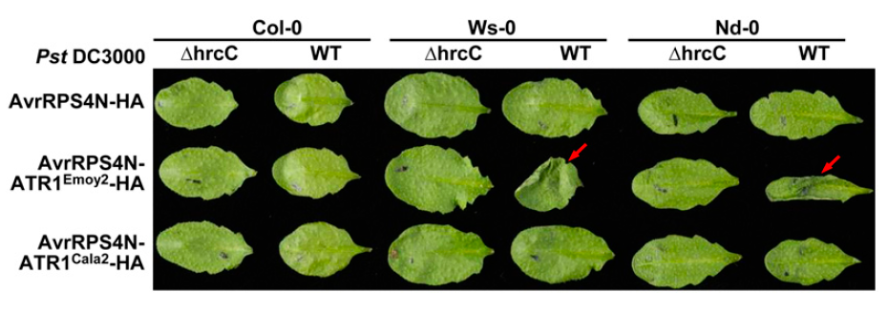
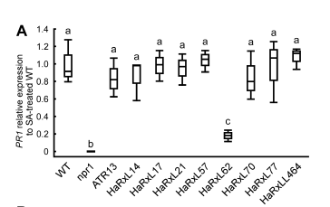
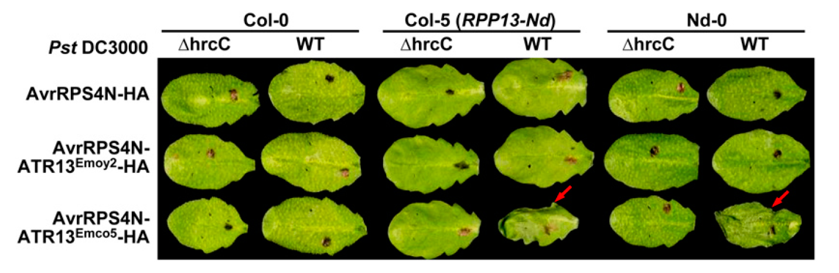
What are functions of Hpa effectors?
- problem: Hpa is currently not transformable -> we cannot delete/add effectors
- alternative approach 1: try to deliver Hpa effectors via Pseudomonas type 3 secretion system
(Sohn et al., Plant Cell 2007; Fabro et al., PLoS Path 2011; Badel et al., MPMI 2013)
- alternative approach 2: express Hpa effectors as transgenes in Arabidopsis
(Anderson et al., Plant J 2012; Caillaud et al., PLoS Biol 2013; Asai et al.; PLoS Path 2014)
Sohn et al., 2007.
Asai et al., 2014

Slide 7
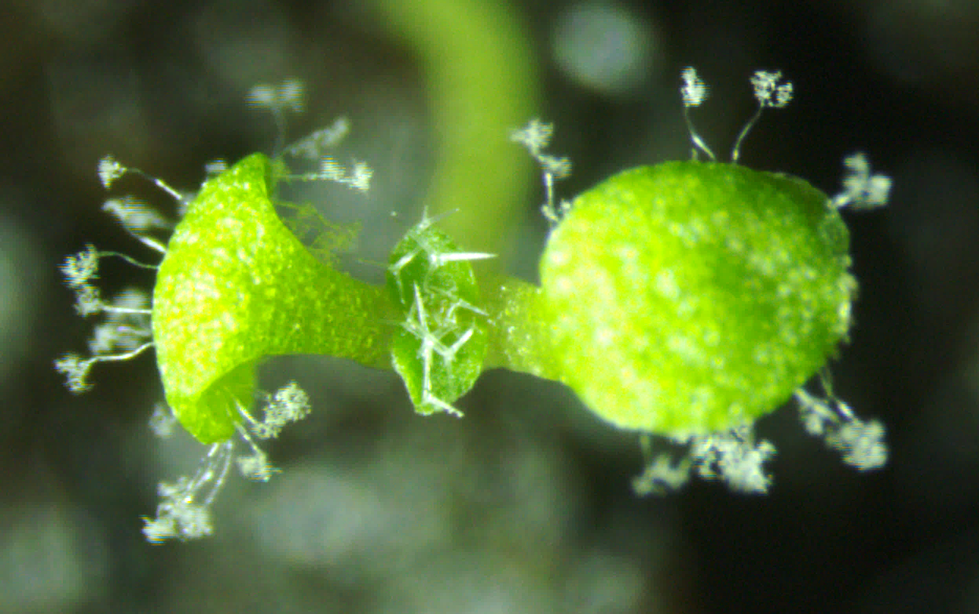
Scoring methods for resistance to Hpa
counting Hpa conidiophores on infected cotyledons (5-7 days after infection)
(compatible or incompatible interaction)
infect cotyledons of 10 - 14 days old seedlings
Percentage of sprangiophores / plant

Slide 8
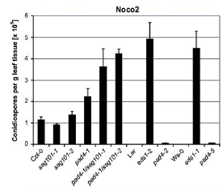
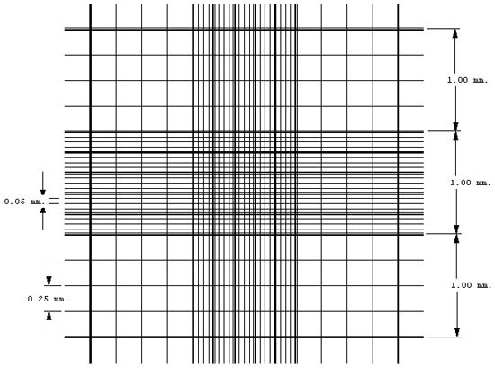
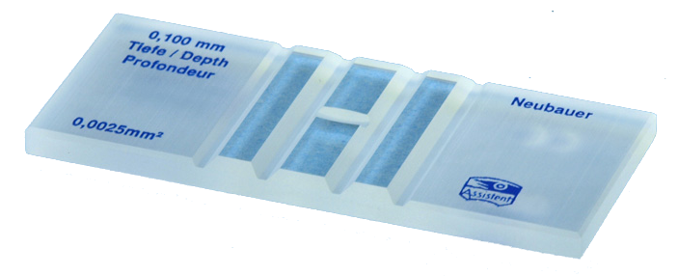
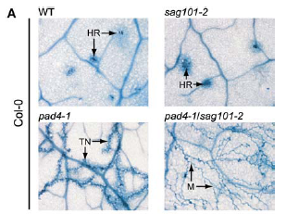
Scoring methods for resistance to Hpa
2) counting Hpa conidiospores washed off from infected adult leaves (5-7 days after infection)
(compatible interaction)
infect 2 week old plants
dilute and count in hemocytometer
normalize to gram fresh weight or plant
3) trypan blue staining of adult leaves (qualitative readout)
(incompatible interaction)
4) qPCR assay to determine ratio Hpa DNA / Arabidopsis DNA
Anderson & McDowell 2015, PMID 25676785

Slide 9
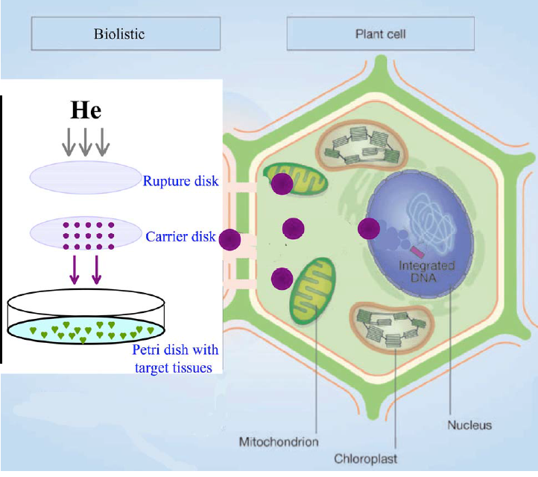
Biolistic Mediated Transformation
◆ Biolistic method (also called as particle bombardment) is a direct physical
method of introducing nucleic acids into cells
◆ Nucleic acids are coated onto high-density gold or tungsten microparticles
◆ Accelerated to high velocity by a helium pulse and delivered into cells

Slide 10
Why Biolistics?
◆ Because of the physical nature of this technology, it is highly versatile and
easy to use
◆ It is a highly powerful method for introducing nucleic acids into wide range of
cell and tissue types
◆ It is much easier than many other methods
◆ It allows transformation of plant species that are not amenable to gene
transfer using other methodologies
◆ It requires less DNA and fewer cells than other methods and can be used for
transient as well as stable transformation

Slide 11
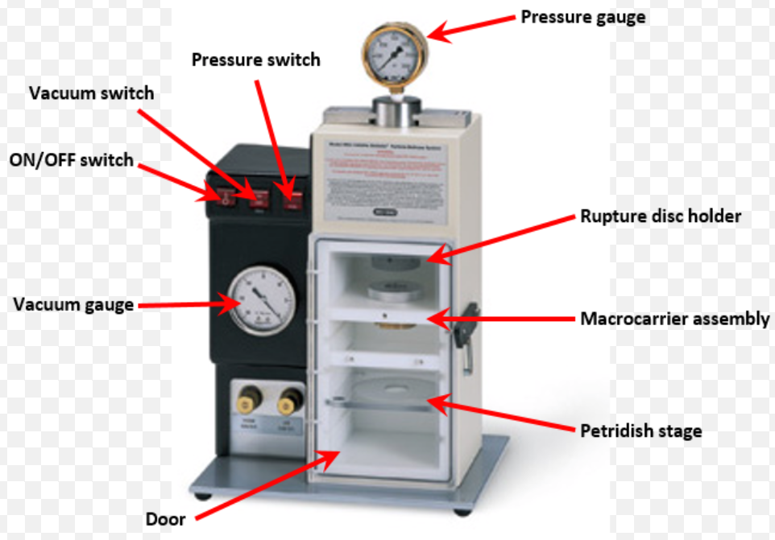
BioRad PDS-1000/He System

Slide 12

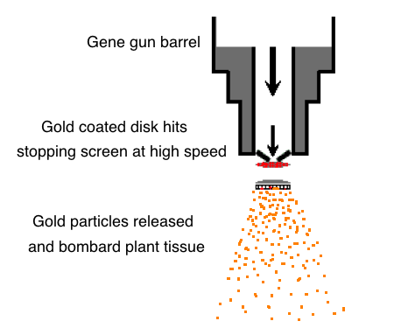
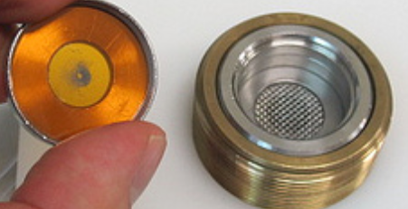
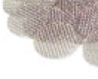
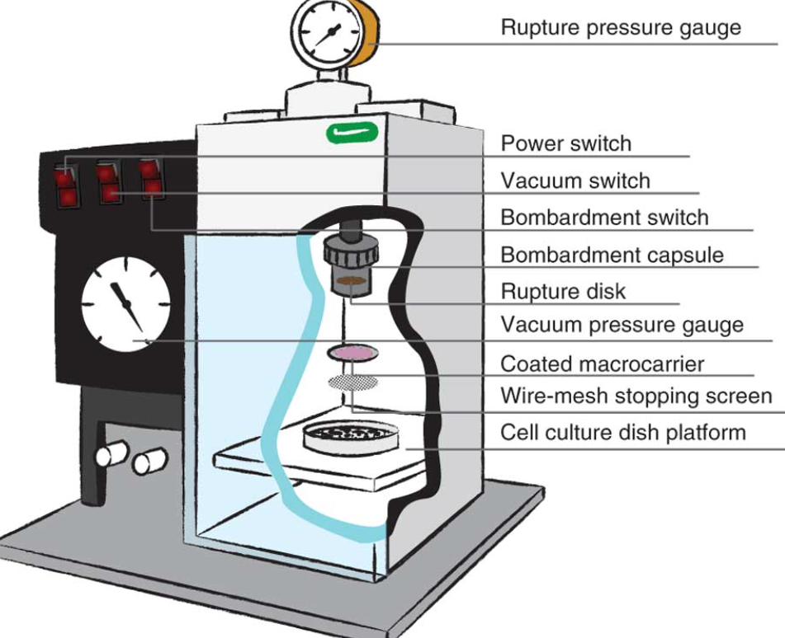
Plasmid with gene of interest
Coat gold or tungsten particles
How does it work?
•The Sample DNA is coated on Tungsten or Gold particles
•The sample to be transformed is placed in the bombardment
chamber, which is evacuated to sub-atmospheric pressure
•The instrument is fired; helium flows into the gas acceleration
tube and is held until the specific pressure of the rupture disk
is reached
•The disk bursts, and the helium shock drives the macrocarrier
disk (which carries the coated microparticles) a short distance
toward the stopping screen
•The stopping screen retains the macrocarrier, while the microparticles pass
through the screen into the bombardment chamber and penetrate the
target cells
*The launch velocity of microcarriers depends on a number of adjustable parameters:
the helium pressure (rupture disk selection, 450–2,200 psi), the amount of vacuum,
the distance from the rupture disk to the macrocarrier, the distance from the
microcarrier launch assembly to the stopping screen, and the distance between the
stopping screen and target cells.
rupture disk
macrocarrier
stopping screen

Slide 13
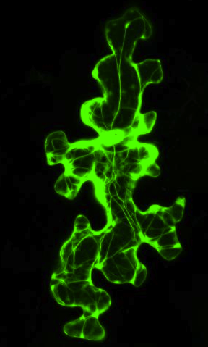
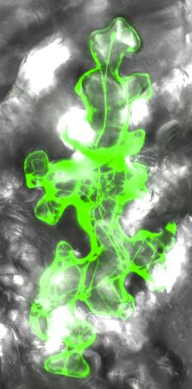
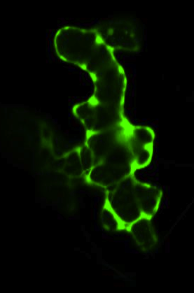
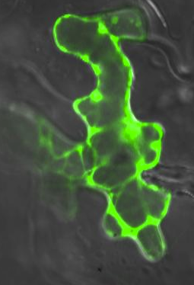
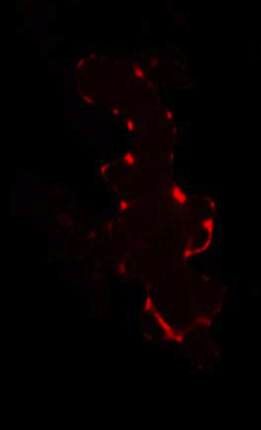
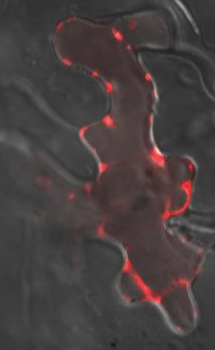
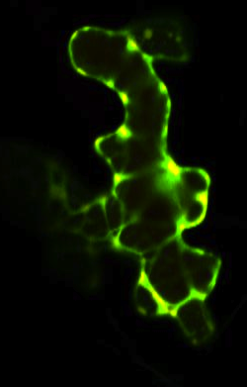
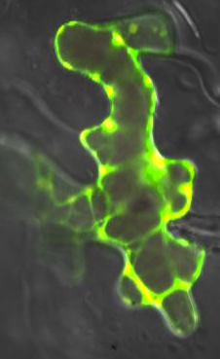
APPLICATIONS
◆ Sub-cellular localization of Proteins
A
GFP
Expression of GFP alone (A) or
together with a Hpa effectorRXLR58-RFP (B)
in Arabidopsis epidermal cells
B
GFP
RXLR58-RFP
Merged

